Slide 1
Project Analysis Presentation

Slide 2
Problem Statement
To Create an Application for Credit card bill payment
Customer should be able to view credit card payment due date and amount.
Customer can able to pay the bill due amount or he can pay different amounts.
Customer can able to view statement history.
Customer can able to view payment history.

Slide 3
Problem Statement
To Create an Application for Credit card bill payment
Customer should be able to view credit card payment due date and amount.
How much he/she has to pay the amount.
Example: due date = 25-03-2021 and amount = 50000
Customer can able to pay the bill due amount or he can pay different amounts.
He/ She can able to modify the amount which has to pay.
Example Due amount: 20,000/- paying : 10,000/- should be accepted.
Customer can able to view statement history.
Billing statements
Customer can able to view payment history.
Bill payments

Slide 4
Bank Account
Module
Transaction module
Login Module
Customer Module
Statement module
Credit Card Module
Payment Module

Slide 5
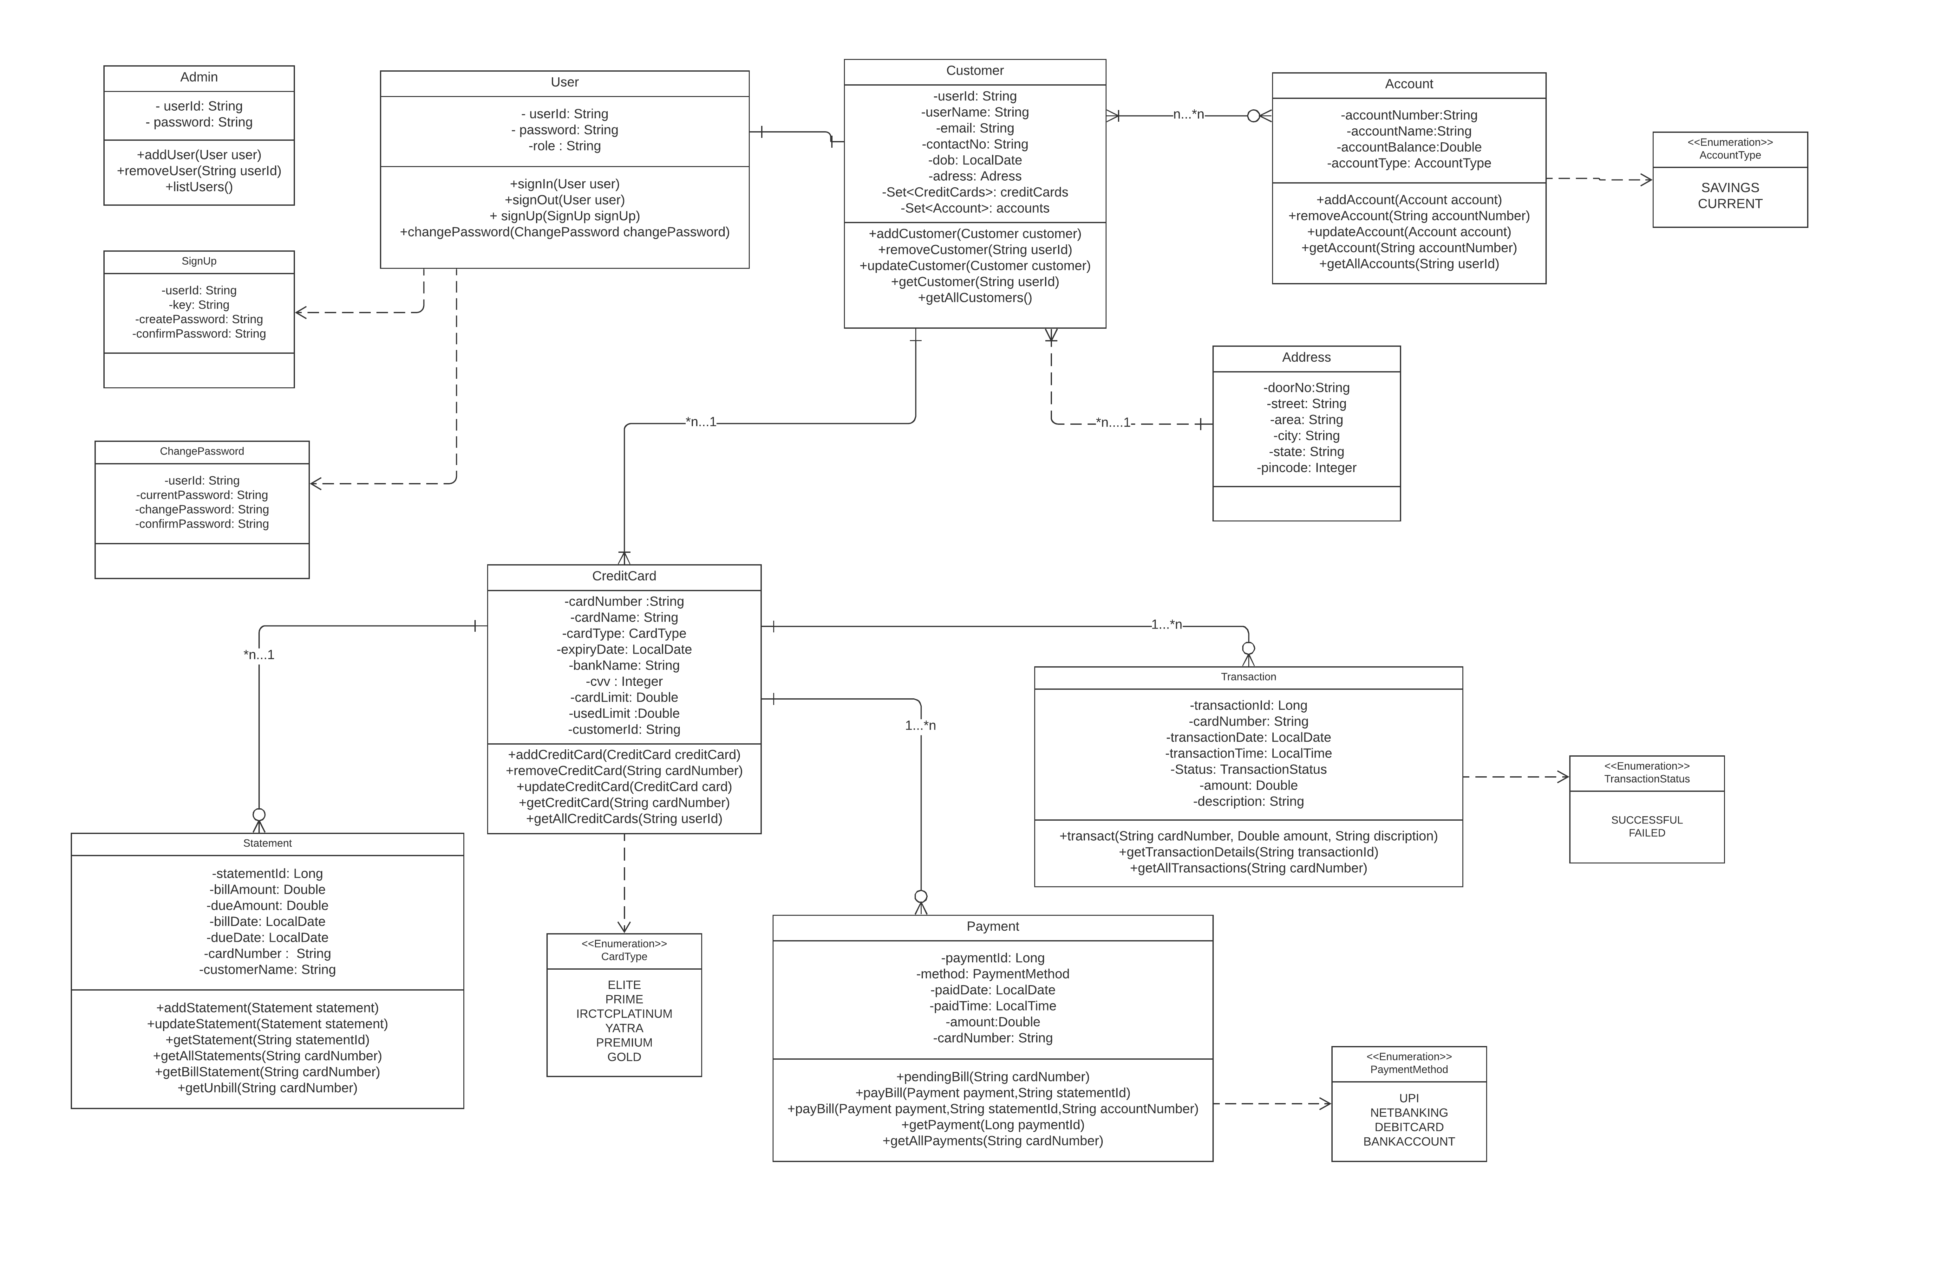

Slide 6
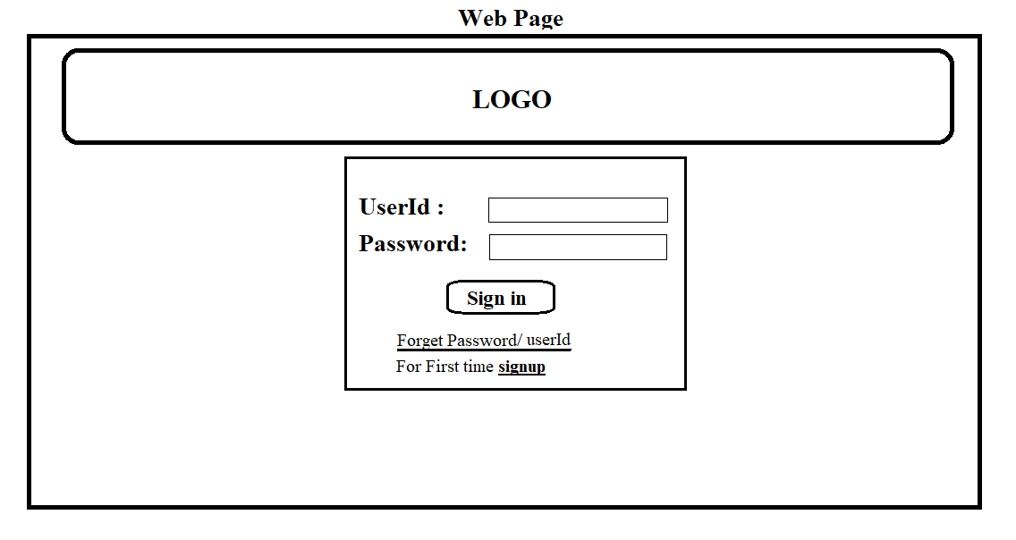
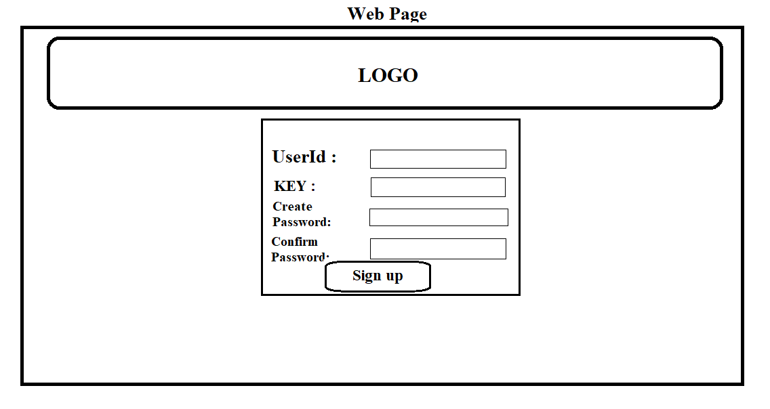
LOGIN MODULE
Admin
Can view the details of customers
User
Can view only his details
UserId and Password should be mapped
userId to everthing should be mapped
Password to be high level ex: abc@123
userId(auto or admin) and key should be generated by Admin
IuserInterface
IuserRepository

Slide 7
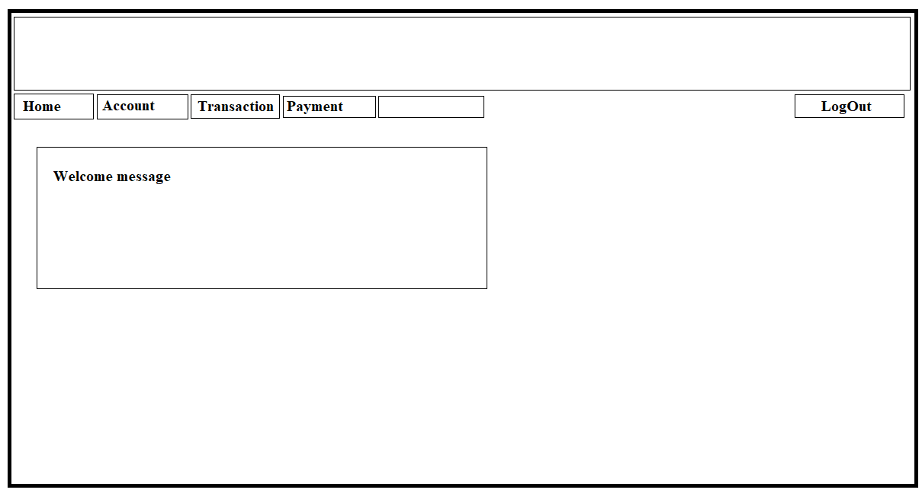
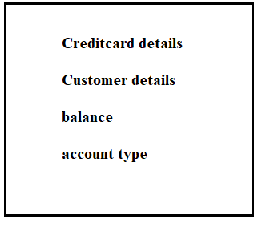
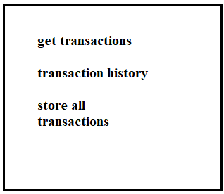
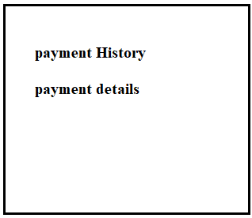
Other MODULES
Admin
Can view the details of customers
Can initiate the details
User
Can modify his details

Slide 9
Thank You

